Slide 1



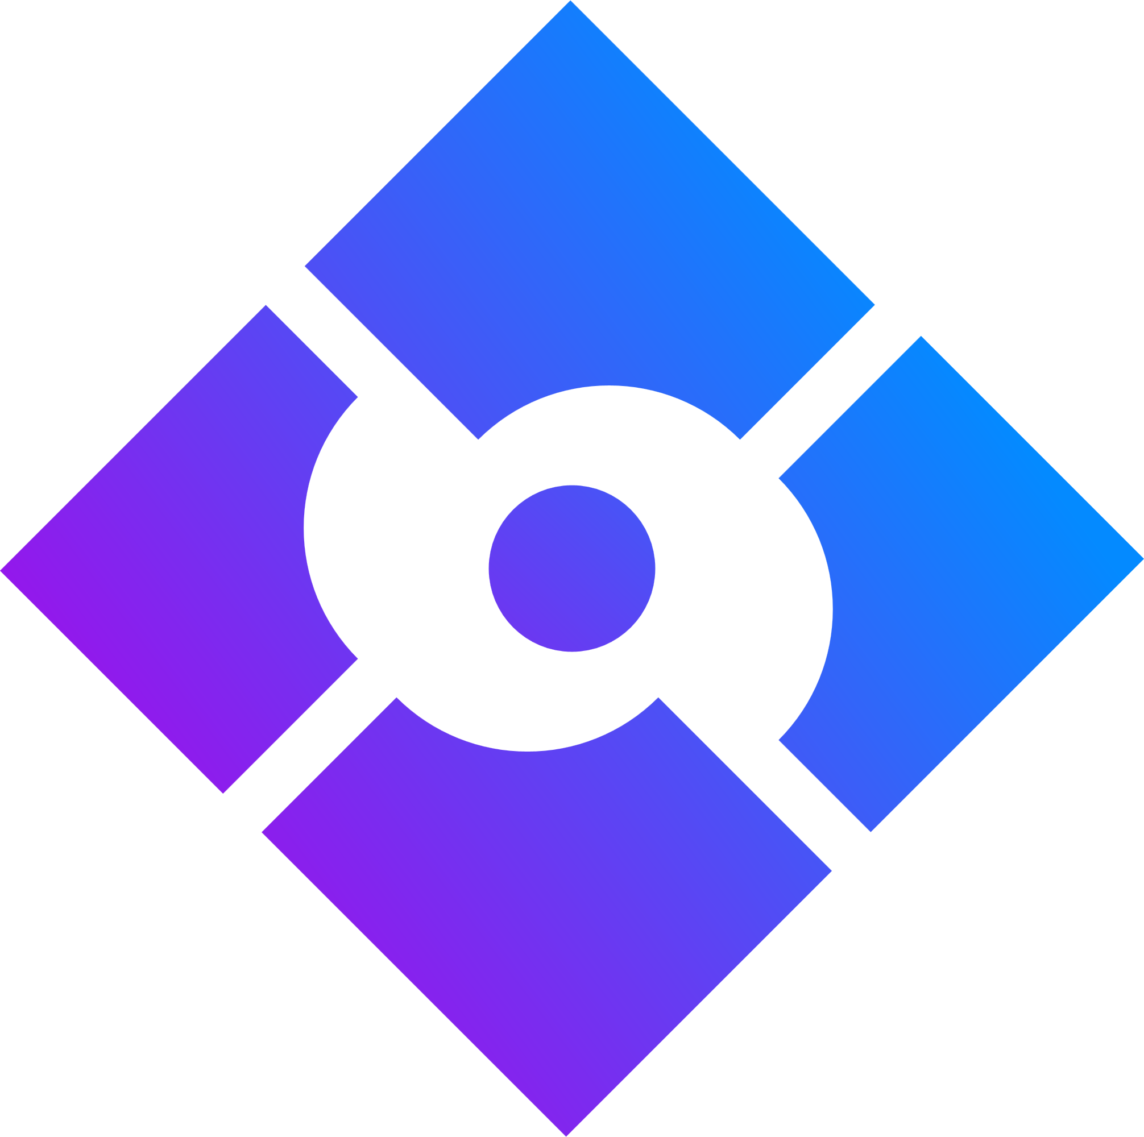
CI CD
PIPELINING

Slide 2
PROBLEM STATEMENT
IMPLEMENTATION OF A CONTINUOUS INTEGRATION AND DEPLOYMENT PIPELINE FOR CONTAINERIZED APPLICATIONS IN AMAZON WEB SERVICES USING JENKINS AND KUBERNETES
Published in: 2020 19th RoEduNet Conference: Networking in Education and Research (RoEduNet)
Date of Conference: 11-12 December 2020
INSPEC Accession Number: 20381706
DOI: 10.1109/RoEduNet51892.2020.9324857
Publisher: IEEE
Artur Cepuc Communications Department Technical University of Cluj-Napoca
Robert Botez Communications Department Technical University of Cluj-Napoca

Slide 3

TECH STACK
AWS
EC2 INSTANCE
GIT
JENKINS
SONARQUBE
MAVEN
KUBERNETES
DOCKER
ARGO CD

Slide 4
OVERVIEW
Nowadays, cloud computing has become the go to solution for most enterprises. This has led to the introduction of Cloud and DevOps techniques in which developers work closely with network engineers in order to ensure fast and reliable deployment of their applications.
This paper presents an entire automated pipeline, starting with detecting changes in the Java-based web application source code, creating new resources in the Kubernetes cluster to host this new version and finally deploying the containerized application in AWS. The solution follows Cloud best practices and relies on Jenkins for the Continuous Integration stage. The solution ensures zero downtime and proves fast, even though it combines six different technologies.

Slide 5

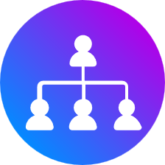

Goals
Implementation
Optimizing
Automate Software Delivery
Improve Code Quality
Enhance Collaboration
Increase Visibility
Foster Continuous Feedback
Parallelization
Argo CD instead of Ansible
Pipeline as Code
Security Scanning

Slide 6





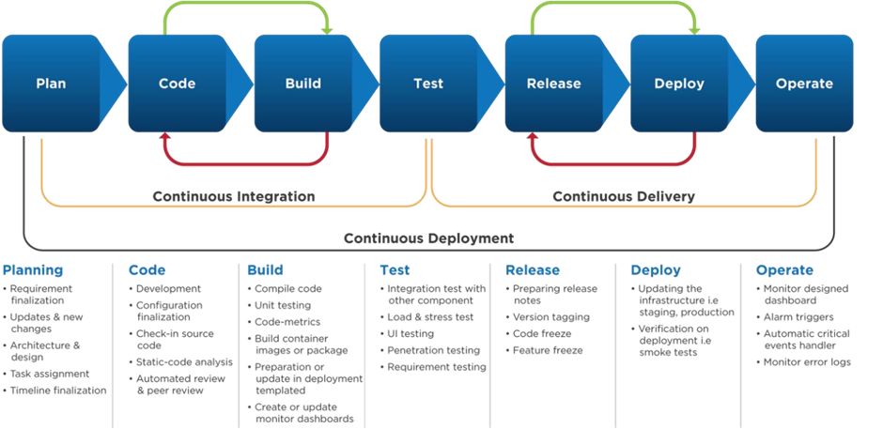
Project Timeline
continuos Integration
continuos delivery
continuos Deployment

Slide 7
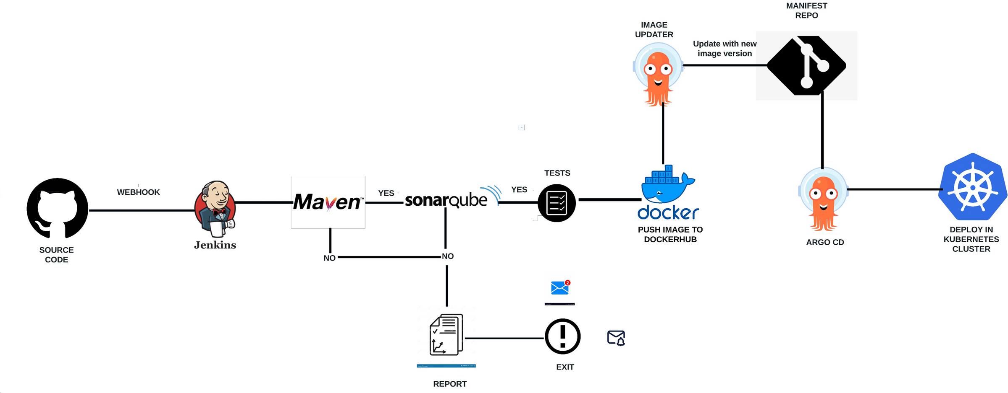
Architecture
CI CD PIPELINING

Slide 8
Continuous Integration (CI) Tools:
Jenkins: Jenkins is one of the most popular CI/CD tools and is primarily used for continuous integration. It can automate building, testing, and deployment of code changes.
Git: While Git is primarily a version control system, it's an essential part of the CI process as it allows developers to collaborate and manage source code, enabling CI pipelines to build and test code from Git repositories.
Continuous Deployment (CD) Tools:
Kubernetes: Kubernetes is a container orchestration platform, and it plays a significant role in the CD process. It can be used for automating the deployment and scaling of containerized applications, making it a CD tool.
Docker: Docker is primarily a containerization tool, but it's crucial for CD as it enables the packaging and deployment of applications in containers, ensuring consistency across different environments.
ArgoCD: ArgoCD is a tool for declarative, GitOps-based continuous deployment. It helps automate the deployment of applications to Kubernetes clusters by syncing with a Git repository.

Slide 9
Additional Tools:
AWS: While AWS itself is not a CI/CD tool, it provides various services and resources that can be integrated into a CI/CD pipeline, such as EC2 instances for Jenkins, AWS CodePipeline for building CI/CD pipelines, and AWS Elastic Beanstalk for deploying applications.
SonarQube: SonarQube is not a CI/CD tool, but it's often integrated into CI pipelines for code quality and security analysis. It helps identify and address code issues early in the development process.
In a typical CI/CD pipeline, Git is used for version control, Jenkins handles CI tasks (build and test), and Kubernetes and Docker (along with ArgoCD) are involved in CD, ensuring deployment and scaling of applications. AWS services complement these tools by providing infrastructure resources, hosting environments, and orchestration capabilities. SonarQube fits into the CI stage for code quality analysis.

Slide 10
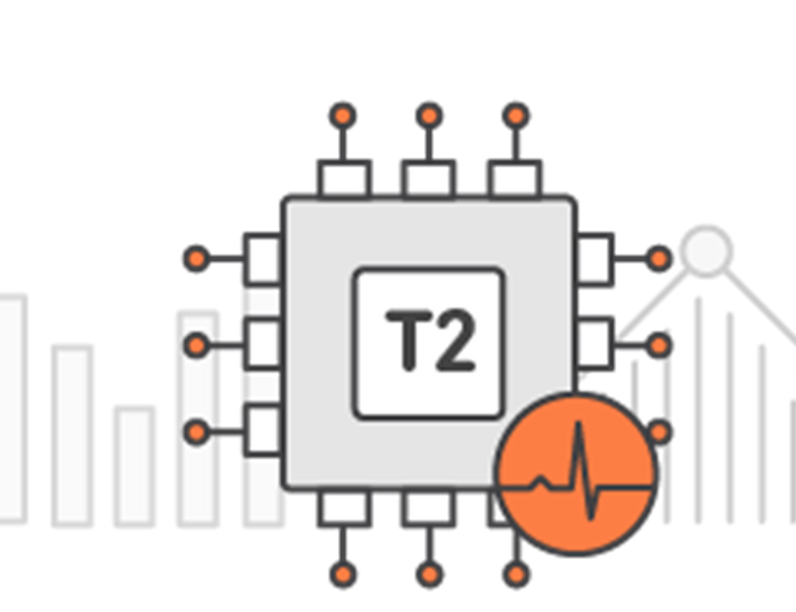
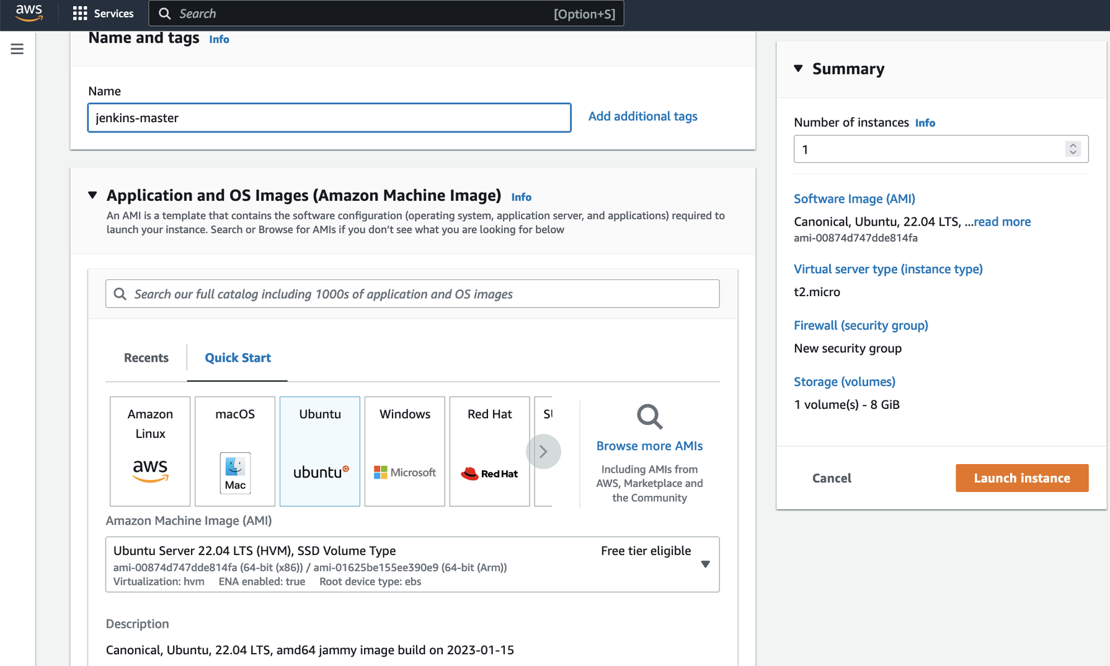
Implementation
Launch EC2 Instance: Create an EC2 instance using the AWS Management Console or AWS CLI. Choosing instance type that suits the needs, and ensure it has adequate resources for running Jenkins and sonarqube.

Slide 11
EC2 T2 LARGE INSTANCE CONFIGURATION
Name: t2.large/t2.medium
vCPUs: 2
RAM (GiB): 8.0
CPU Credits/hr: 36
Security Groups : all traffic
On-Demand Price/hr: $0.0928
1-yr Reserved Instance Effective Hourly Price: $0.055
BURSTABLE CPU PERFORMANCE
BURSTABLE EBS PERFORMANCE

Slide 12
Cost-Effective Resource: The t2.large instance balances CPU and memory resources, making it cost-effective for running various CI/CD tools and services without overspending on larger instance types.
Scalability: T2 instances can burst their CPU performance when needed. This makes them suitable for handling build and deployment spikes during CI/CD pipeline execution without the need for constant high CPU capacity.
Testing Environment: You can use the t2.large instance as a test and staging environment where you can perform integration testing, quality assurance, and pre-production validation of application changes before deployment.
Parallel Builds: The t2.large instance can handle parallel builds, which is essential for a CI/CD pipeline. It enables you to build multiple code branches simultaneously, speeding up the development and testing process.
Docker Support: EC2 t2.large instances are compatible with Docker, making it easy to containerize your applications and run them on these instances. Docker can simplify application deployment and management within your pipeline.
Custom Configuration: You can configure the t2.large instance with the necessary software, development tools, and automation scripts required for your CI/CD workflow.

Slide 13

JENKINS
Jenkins is an open-source automation server and continuous integration/continuous delivery (CI/CD) tool that helps automate various aspects of software development and delivery processes. It is a widely used platform for building, testing, and deploying code changes.
Automation: Jenkins automates various tasks in the software development lifecycle, including building, testing, and deploying applications. It can be configured to trigger these tasks automatically in response to code changes or on a scheduled basis.
Continuous Integration (CI): Jenkins facilitates continuous integration, where code changes from multiple developers are frequently integrated into a shared repository. It ensures that integration issues are detected and resolved early in the development cycle.
Plugin Ecosystem: Jenkins has a rich ecosystem of plugins that provide integration with various tools, services, and technologies. These plugins extend Jenkins' functionality and enable it to work seamlessly with version control systems, build tools, cloud platforms

Slide 14
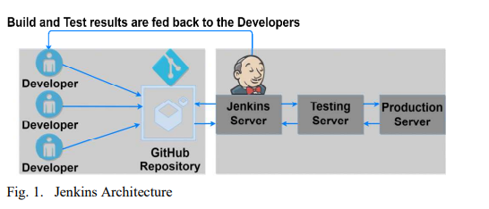
JENKINS USAGE
Automation Hub: Jenkins serves as the automation hub of the CI/CD pipeline, automating various stages from code integration to deployment.
Continuous Integration: Jenkins facilitates continuous integration, where code changes are automatically built, tested, and integrated into the main codebase multiple times a day.
Plugin Ecosystem: Jenkins has a vast plugin ecosystem, allowing integration with a wide range of tools and services, such as Git, Docker,SonarQube Scanner, and more.
Scheduled Builds: Jenkins can schedule and automate builds at specified intervals or in response to code changes, ensuring consistent, timely integration.
Parallel Execution: Jenkins supports parallel execution of tasks, enabling efficient use of resources for tasks like running tests in multiple environments.

Slide 15
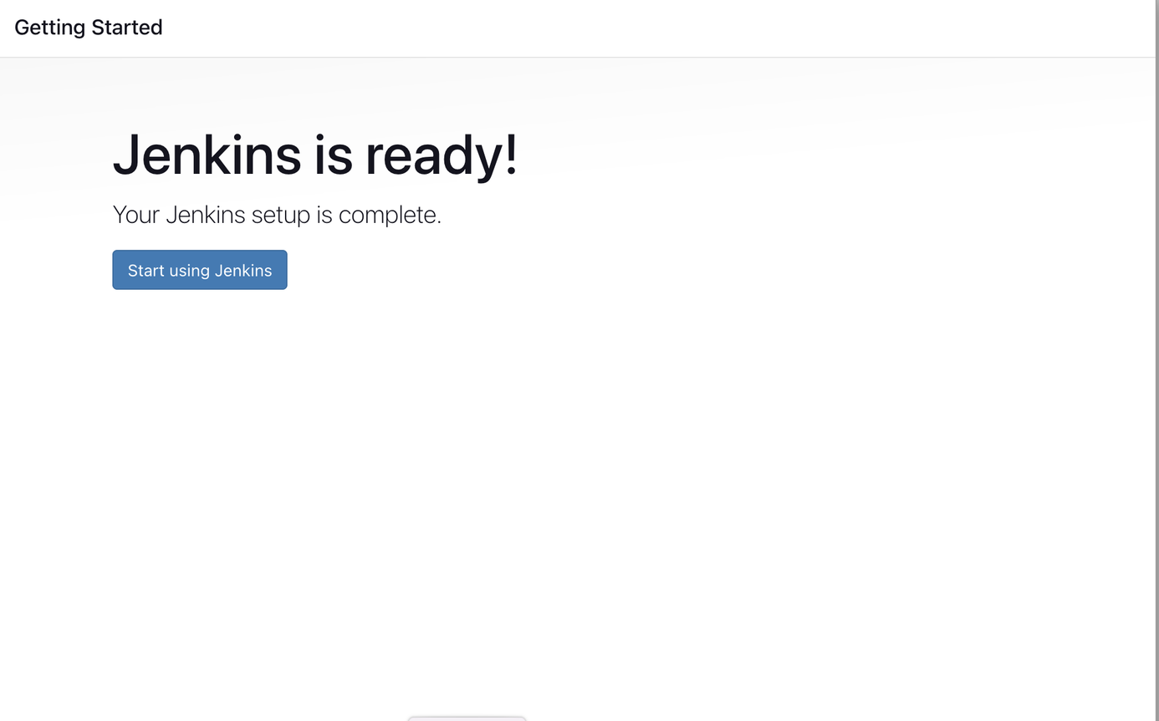
Configuration
Installation and Setup
Plugins Management
Job Creation
Pipeline DSL
Security and Access Control
Environment Variables
Integration with Tools
Artifacts and Deployment
Monitoring and Logging
Scalability

Slide 16
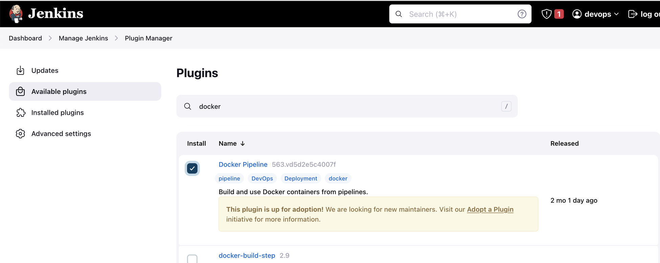
JenkinsFile-Build Steps
Jenkinsfile is a configuration file written in a domain-specific language known as the "Declarative Pipeline DSL" or the "Scripted Pipeline DSL." It is used in Jenkins to define and describe the entire CI/CD pipeline workflow as code. Jenkinsfiles play a crucial role in defining, automating, and orchestrating the steps and stages of your pipeline

Slide 17
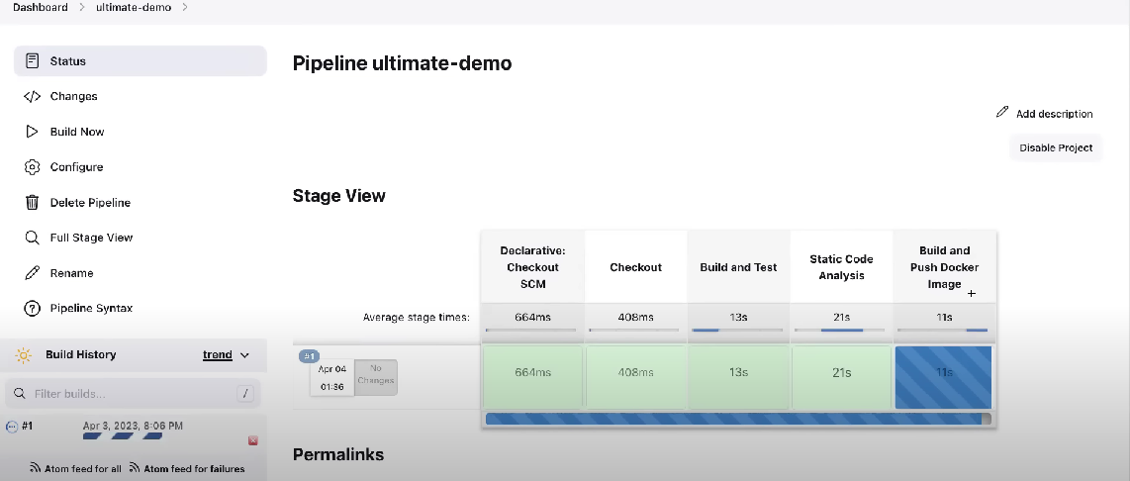
Jenkinsfile Execution
Trigger
Jenkinsfile Execution
Workspace
Checkout Code
Building and Compilation
Testing
Artifact Generation
Reporting and Notifications
Artifact Archiving
Publishing Artifacts

Slide 18
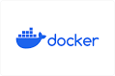
Docker
Docker is an open-source platform for developing, shipping, and running applications in containers.
Containers: Containers are lightweight, standalone, and executable packages that contain everything needed to run an application, including code, runtime, system tools, libraries, and settings.
Docker Image :Docker image is the source of Docker container. In other words, Docker images are used to create containers. When a user runs a Docker image, an instance of a container is created.
DockerFile
: Text file that contains a set of instructions for building a Docker image.
Image Blueprint: It serves as a blueprint for creating Docker images that include your application and its dependencies.
Instructions: Each line in a Dockerfile represents a specific instruction for building the image.

Slide 19
WHY DOCKER IN CICD
We use docker as an agent which will help us achieve a reduced footprint of build agents, minimizing resource consumption such as memory and CPU
Docker containers encapsulate an application and its dependencies in a consistent environment, ensuring that the application behaves the same way in development, testing, and production. This consistency helps eliminate the "it works on my machine" problem.
Docker containers can run on any system that supports Docker, making it easy to move applications between different environments, including local development, testing, staging, and production. This portability reduces deployment issues and streamlines the CI/CD process.
Docker containers are lightweight and can be quickly started and stopped. This makes it easy to scale your CI/CD infrastructure as needed.
Docker containers consume fewer resources compared to traditional virtual machines, making better use of hardware and speeding up the pipeline execution.

Slide 20
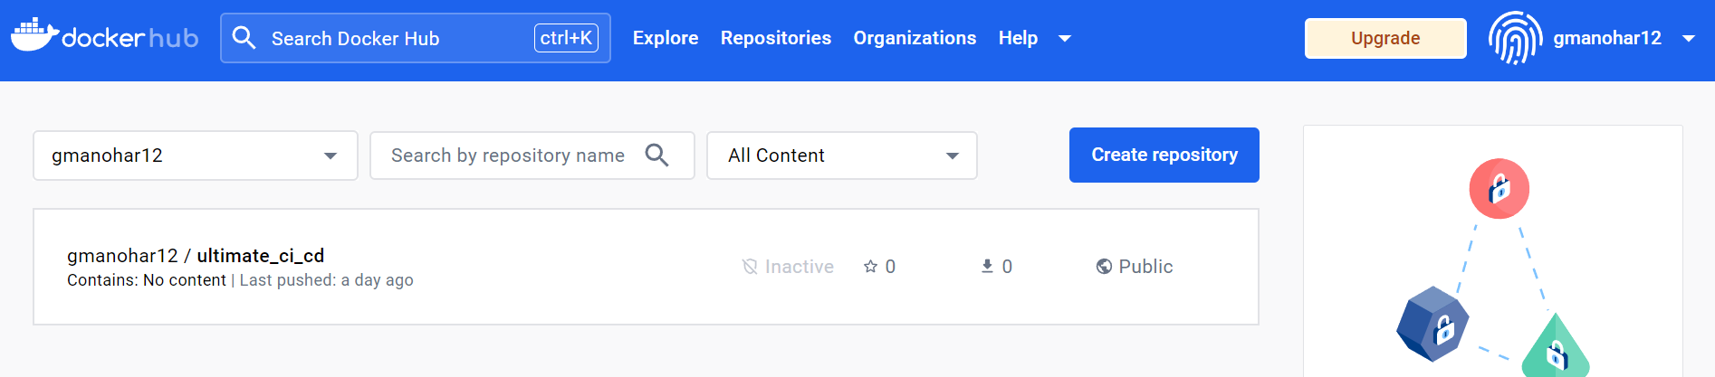
DockerHub
Docker Hub is a cloud-based platform provided by Docker that serves as a central repository for Docker images. It plays a key role in the Docker ecosystem, offering several important functions:
Image Repository: Docker Hub is a hosting service where developers and organizations can store and manage Docker images. These images can contain applications, libraries, or any software components that can be containerized.
Image Distribution: Docker Hub provides a centralized location for distributing Docker images. Users can push (upload) their images to Docker Hub, and others can pull (download) those images to use in their own environments.

Slide 21
Using Docker in CI/CD - Workflow:
Dockerization: Dockerize your application by creating a Dockerfile that specifies the application's dependencies, configuration, and how it should be built into a container image.
Container Registry: Push the Docker image to a container registry (e.g., Docker Hub, Amazon ECR, Google Container Registry) where it can be stored and accessed.
Continuous Integration: In your CI/CD pipeline, build and test your application, creating a Docker image as part of the process.
Artifact Storage: Store the Docker image as an artifact for later use in deployment.
Deployment: Deploy the Docker image to a target Kubernetes Cluster, which can be a development, staging, or production environment.

Slide 22

Apache Maven
Build Automation: Apache Maven is a build automation and project management tool that simplifies the building of Java applications. It automates tasks such as compiling source code, managing dependencies, and packaging artifacts.
Standardized Project Structure: Maven enforces a standardized project structure, making it easier for teams to understand and work on Java projects. This consistency is particularly useful in CI/CD pipelines.
Dependency Management: Maven handles dependency management efficiently. It resolves and downloads project dependencies from repositories, ensuring that your Java application has the required libraries and components.
Plugin Ecosystem: Maven offers a wide range of plugins, including integration with CI/CD tools. You can use these plugins to customize your build and deployment processes within the CI/CD pipeline.
POM Files: Projects are defined by Project Object Model (POM) files. These XML files contain project configuration, dependencies, build instructions.

Slide 23

SonarQube
Implementing SonarQube in a CI/CD (Continuous Integration/Continuous Deployment) pipeline is a best practice to ensure code quality and security throughout the software development lifecycle. SonarQube is a popular tool for static code analysis, code quality assessment, and vulnerability detection.
SonarQube Setup:
Install and configure SonarQube server - EC2 Instance
Install and configure SonarQube Scanner - plugin in Jenkins
CI/CD Configuration:
Configuring CI/CD pipeline to include a SonarQube analysis step as part of the build or integration process. This step typically comes after code compilation and testing.
Ensuring CI/CD environment can access the SonarQube server, including the server's URL and authentication credentials (token).

Slide 24
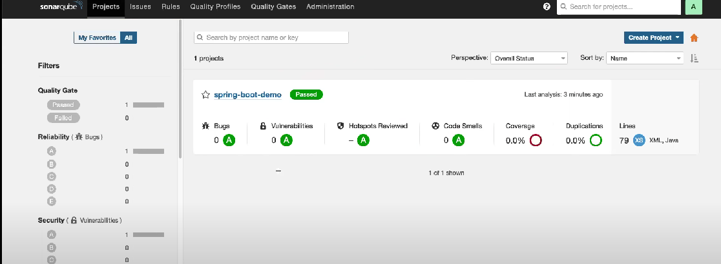
SonarQube Analysis:
In CI/CD pipeline, use the SonarQube Scanner to analyze your source code. This step will run static code analysis and collect various metrics, including code quality, code coverage, and security vulnerabilities.
Quality Gates:
Defining quality gates in SonarQube to establish specific criteria that your code must meet for it to be considered acceptable. Quality gates can include thresholds for code coverage, maintainability, and security standards.
CI/CD pipeline should be configured to check whether the code meets these quality gate criteria. If it doesn't, the pipeline may fail, preventing the code from being deployed

Slide 25
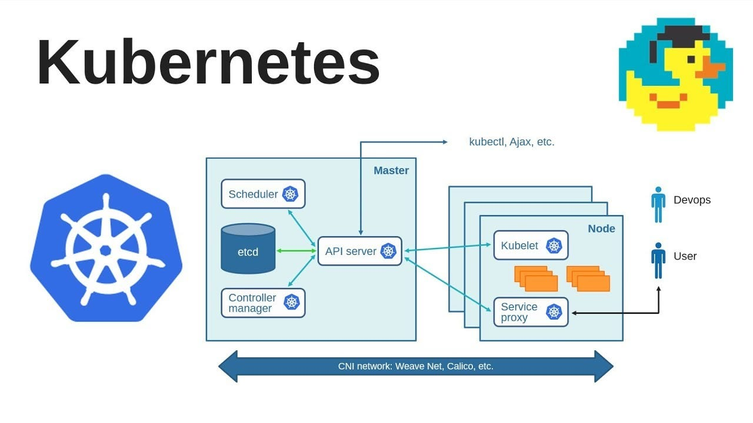
Kubernetes
Container Orchestration: Kubernetes is an open-source container orchestration platform that automates the deployment, scaling, and management of containerized applications.
Cluster Management: It provides tools for managing clusters of containers and ensures the efficient use of resources across a cluster of machines.
Portability: Kubernetes abstracts away infrastructure specifics, making applications portable and eliminating the "it works on my machine" problem.
Scaling: It can automatically scale applications up or down based on load, improving resource utilization.
Kubernetes streamlines the deployment of containerized applications in CI/CD pipelines, ensuring consistency, scalability, and reliability. It abstracts away infrastructure concerns and automates many aspects of application management, making it a powerful tool in modern software delivery.

Slide 26
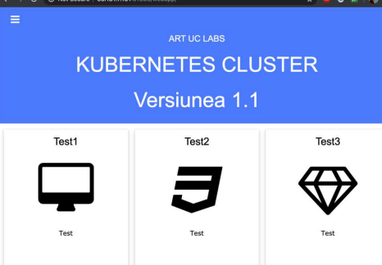
Why Kubernetes in CI/CD Pipelining:
Containerization: Kubernetes enables the deployment of applications as containers, ensuring consistency from development to production.
Scalability: It scales applications seamlessly to meet varying demands, crucial for CI/CD pipelines with fluctuating workloads.
Rolling Updates: Kubernetes supports rolling updates, allowing for smooth and zero-downtime deployments in CI/CD.
Self-Healing: It automatically replaces failed containers or nodes, improving pipeline reliability.
Using Kubernetes in CI/CD Pipelining - Workflow
Dockerize Application: Containerize your application using Docker, creating a Docker image that packages the app and its dependencies.
Container Registry: Push the Docker image to a container registry like Docker Hub, Amazon ECR, or Google Container Registry.

Slide 27
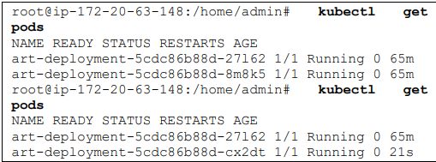
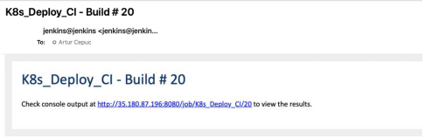
Artifact Storage: Store the Docker image as an artifact for later use.
Deployment Manifests: Define Kubernetes deployment manifests (YAML files) that describe how the application should be deployed on a Kubernetes cluster. This includes specifying container image references, replicas, ports, and other configurations.
CI/CD Automation: Integrate Kubernetes commands or scripts into your CI/CD pipeline to automate the deployment process.
Deployment: Deploy your application to the Kubernetes cluster using kubectl commands, a Kubernetes deployment tool, or by applying the deployment manifests.
Rolling Update: If updating the application, Kubernetes can perform a rolling update, ensuring zero-downtime as new containers are gradually rolled out.
Service Exposing: Create a Kubernetes service to expose the application to the external world. This can be a LoadBalancer service or an Ingress resource, depending on your infrastructure.

Slide 28
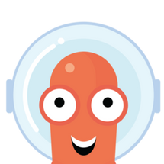
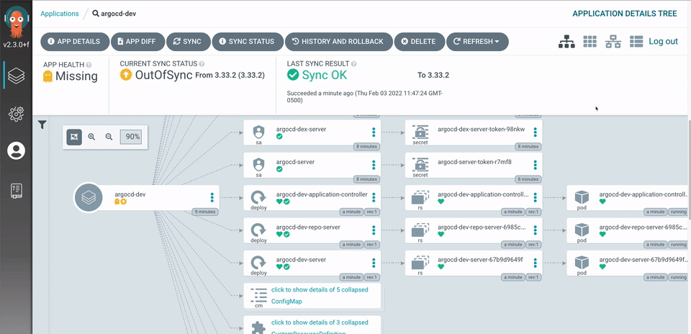
ArgoCD
Argo CD is a popular GitOps continuous delivery tool that's used to automate the deployment and management of applications on Kubernetes clusters. Here's an overview of how Argo CD is used in a CI/CD pipeline, along with the flow of its implementation with Kubernetes:
Usage in CI/CD Pipelining:
GitOps Principles
Version-Controlled Configuration
Automation
Rolling Updates
Declarative Configuration
Policy Enforcement

Slide 29
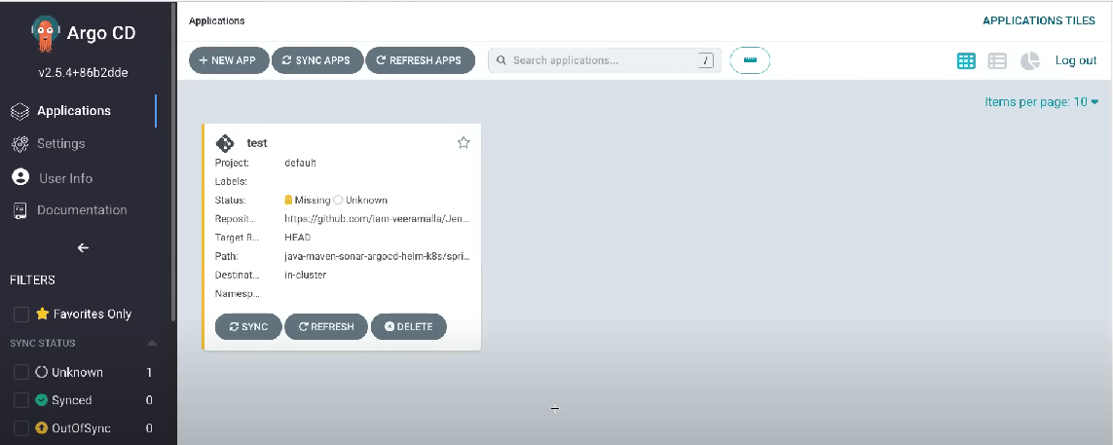
Flow of Implementation with Kubernetes:
Installation: Deploy Argo CD within your Kubernetes cluster. This involves creating the necessary custom resources, such as Custom Resource Definitions (CRDs), and deploying Argo CD components, including the API server, controller, and web UI.
Application Definitions: Create application definitions in your Git repository, specifying the desired state for each application, including the source repository, target namespace, and any parameters.
Git Repository: Store your application definitions and Kubernetes manifests in a Git repository. This repository will serve as the source of truth for your applications.
Argo CD Configuration: Configure Argo CD to connect to the Git repository. Argo CD should authenticate with the Git repository to pull application definitions and manifest.

Slide 30
CONCLUSION AND FUTURE WORK
Automated CI/CD Pipeline: Successfully implemented an automated CI/CD pipeline for deploying a Java-based web application in AWS, streamlining the software delivery process.
DevOps Best Practices: Adhered to industry-standard Cloud best practices, ensuring a collaborative and efficient approach to software development and deployment.
Reliability and Zero Downtime: Demonstrated a reliable deployment process with zero seconds of downtime, ensuring uninterrupted service availability.
Rapid Response to Code Changes: Achieved rapid response to changes in source code, triggering a sequence of events involving six different technologies in just 37.6 seconds.
Automated Error Handling: Implemented automated error detection and rollback mechanisms for failed Jenkins job deployments, ensuring system stability.

Slide 31
SCOPE for Future Work:
Multi-Cloud Deployment: The future work scope involves extending the existing CI/CD pipeline to multiple public and private cloud platforms. This expansion aims to provide deployment flexibility and redundancy, catering to diverse user preferences and business requirements.
Latency-Aware Cloud Selection Algorithm: The development of a latency-aware cloud selection algorithm is crucial for optimizing web application deployment. This algorithm will assess the latency characteristics of available cloud providers and intelligently choose the most suitable one for each deployment, ensuring optimal performance and user experience.
GitOps Approach with Argo CD: As an alternative to Ansible, future work may explore the implementation of a GitOps approach using Argo CD for the CD process. Leveraging Argo CD allows for declarative, version-controlled application deployment, simplifying and automating the management of Kubernetes resources. This transition can further enhance the reliability, scalability, and ease of application deployment in the CI/CD pipeline

